Slide 1
Connect2Coordinator (C2C) Workflow Refresher

Slide 2
Today’s Session
Agenda
9:00 AM - Welcome
9:30 AM – Workflow
11:00 AM– Break for Lunch
12:00 PM - Scenarios + Workflow
1:30 PM - Assignment
1:45 PM - Questions and Feedback
Adjourn

Slide 3
HIPAA Reminder
As the Community-Based Workforce, you should only be viewing clients you are working with. Reviewing any other client’s profile for any reason other than directly tied to work, is strictly prohibited.
New instance of care? New consent.
Consent does not follow the client from service to service. Just because another provider, program, or Community-Based Worker previously obtained consent does not mean that consent automatically applies to the service you are providing today.
Each new instance of care requires you to confirm the client understands what they are agreeing to and obtain the appropriate current consent/authorization for that service.
Think of it this way:
New care → New conversation → New consent.

Slide 4
C2C Workflow Overview
By staying in the Workflow and completing each step in order, you are also completing the activities needed to meet your Key Performance Indicators (KPIs).
🔵 Add New Client
🔵 Enroll Client – Programs & Tasks
🔵 Review Case & Assign to Appropriate Case Manager
🔵 Outreach & Program Introduction
🔵 Obtain Consent & Authorization
🔵 Complete HRSN Screening / Identify Needs
🔵 Make Outbound Referrals
🔵 Document Service Delivery & Follow-Up
🔵 Complete Discharge / Close the Case
Follow the Workflow → Complete the Tasks → Meet the KPIs
The Workflow isn't extra work — it is the work.
Notes:
Create handout
Step 1:
Outreach & Program Introduction
Review script and client information
Call your client and introduce yourself and the program
Ask for permission (verbal consent) to work together
Step 2:
Record Consent & Authorization
Send the electronic consent and authorization form
Ask for it to be returned in 7-days
Step 3:
Complete Assessments
Learn more about the client’s health-related social (HRSN) needs by completing the assessments
Step 4:
Set Goals
Based on the HRSN Assessment, set goals and create an action plan with your client
Step 5:
Find Resources & Make Referrals
Look for resources that will help your client meet their goals
Make referrals to resource agencies
Reach out to resources to complete the referrals, or support your client to do so independently
Step 6:
Progress Update
After 1-2 weeks of making referrals, check-in with your client to see if they were able to get connected and receive support
Provide education and coaching based on your client’s needs
Step 7:
Ready for Discharge?
Based on what you learned in the progress update, determine if your client has met their goals and is ready for discharge
If yes- proceed to step 8
If no- go back to step 5 and repeat 5-7 until your client has met their goals and is ready for discharge
Step 8:
Complete Discharge Form
Do a warm handoff if your client is going to receive ongoing case management from another program
Document the reason for discharge

Slide 5
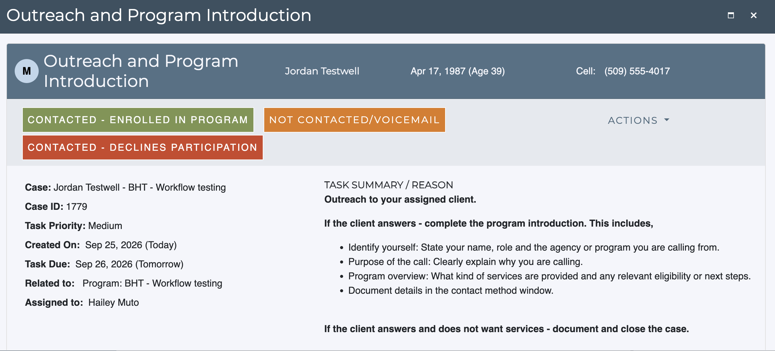
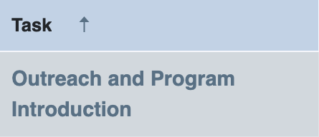
Outreach and Program Introduction

Slide 6
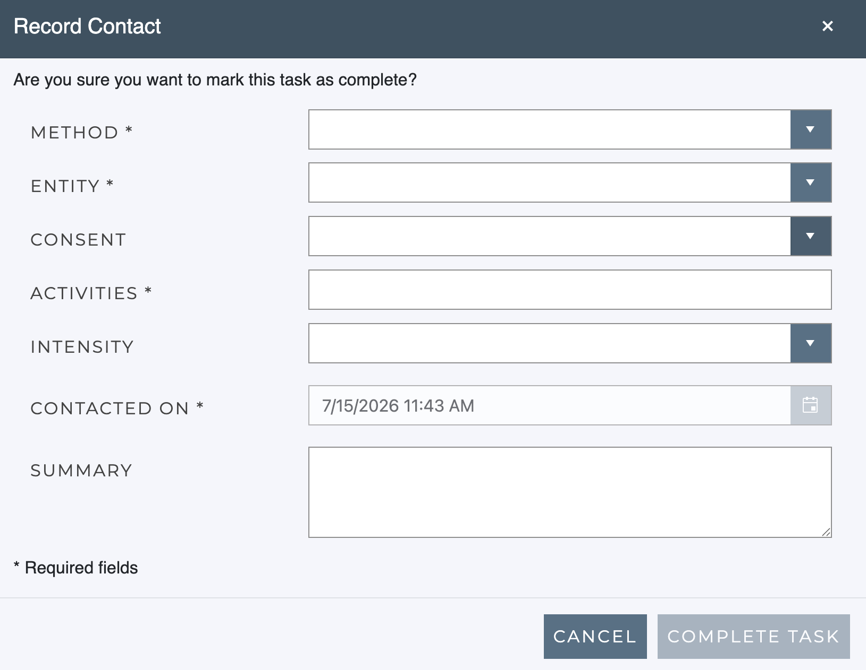
Outreach & Program Introduction – Record Contact

Slide 7
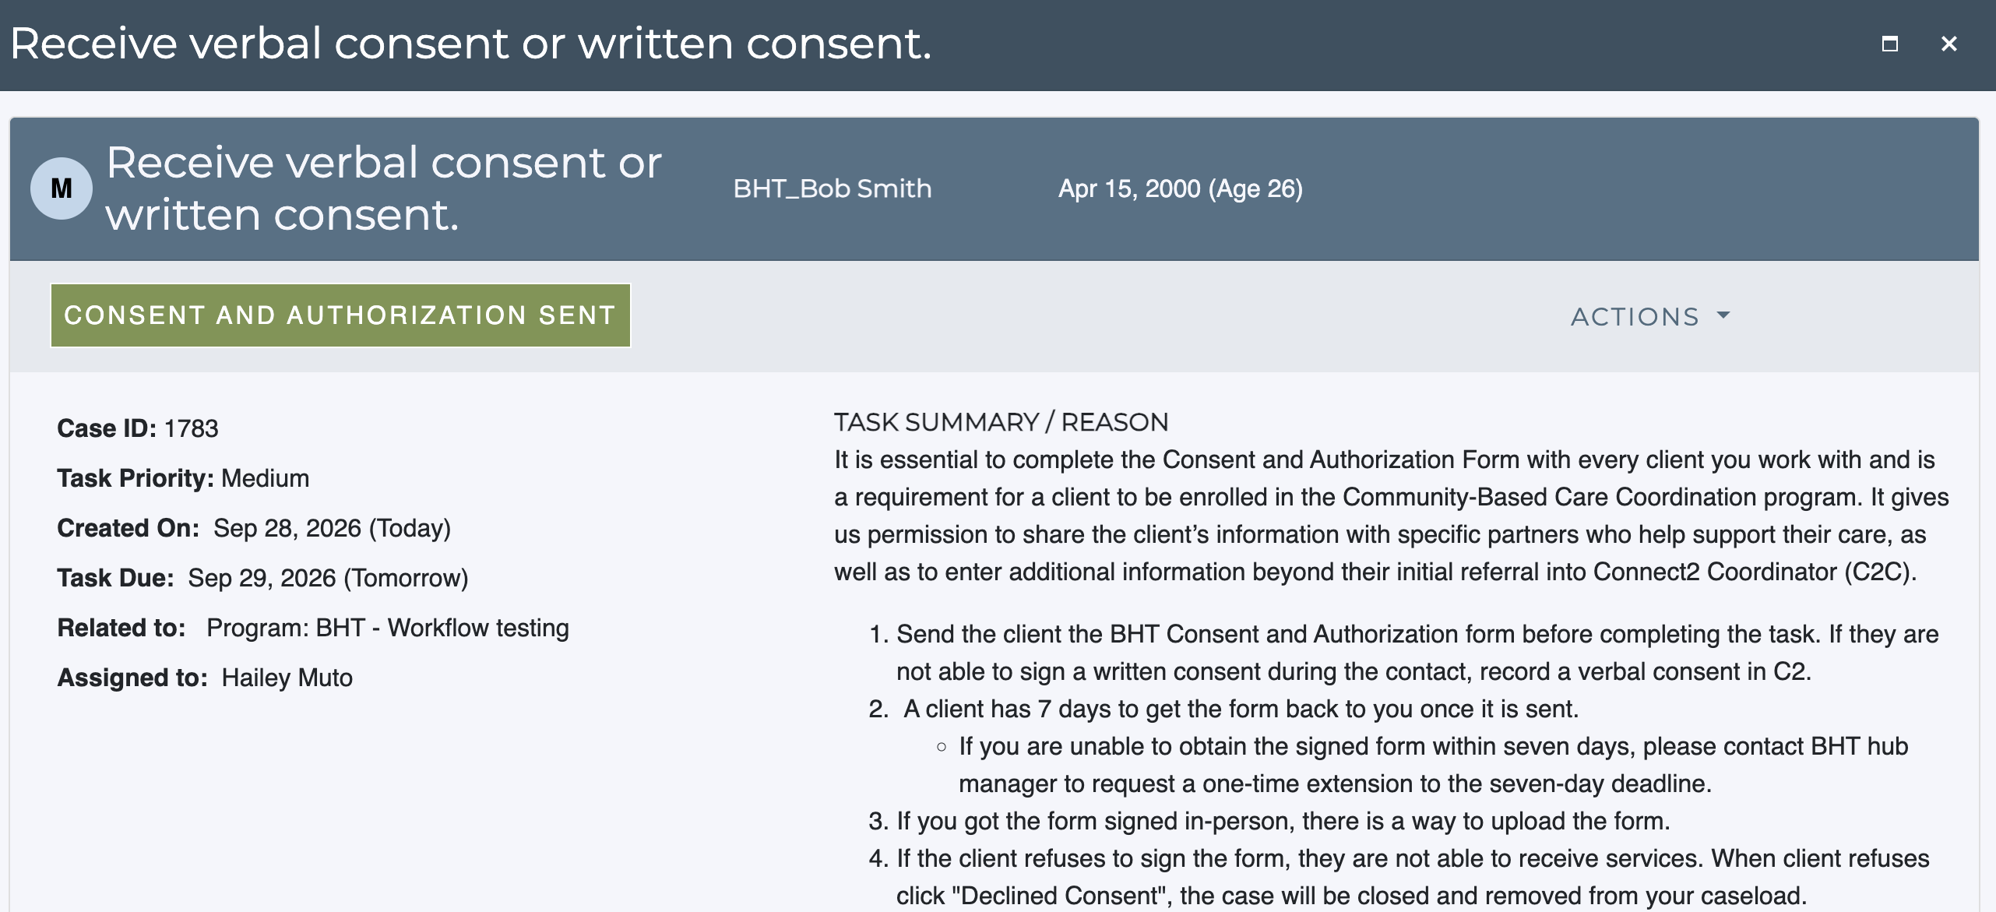
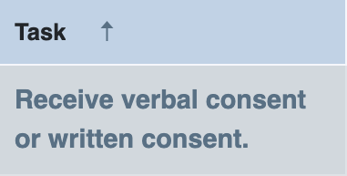
Receive verbal consent or written consent

Slide 8
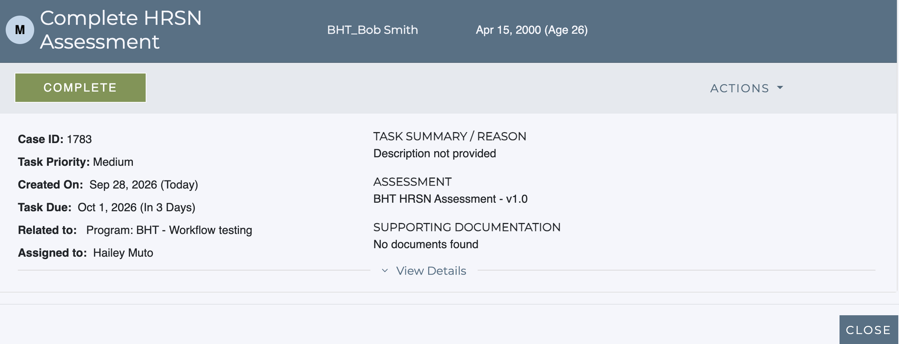
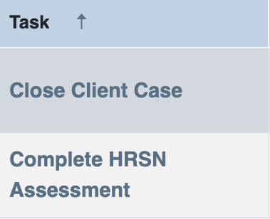
Complete HRSN Assessment
Notes:
Let’s go to Dashboard and then click All

Slide 9
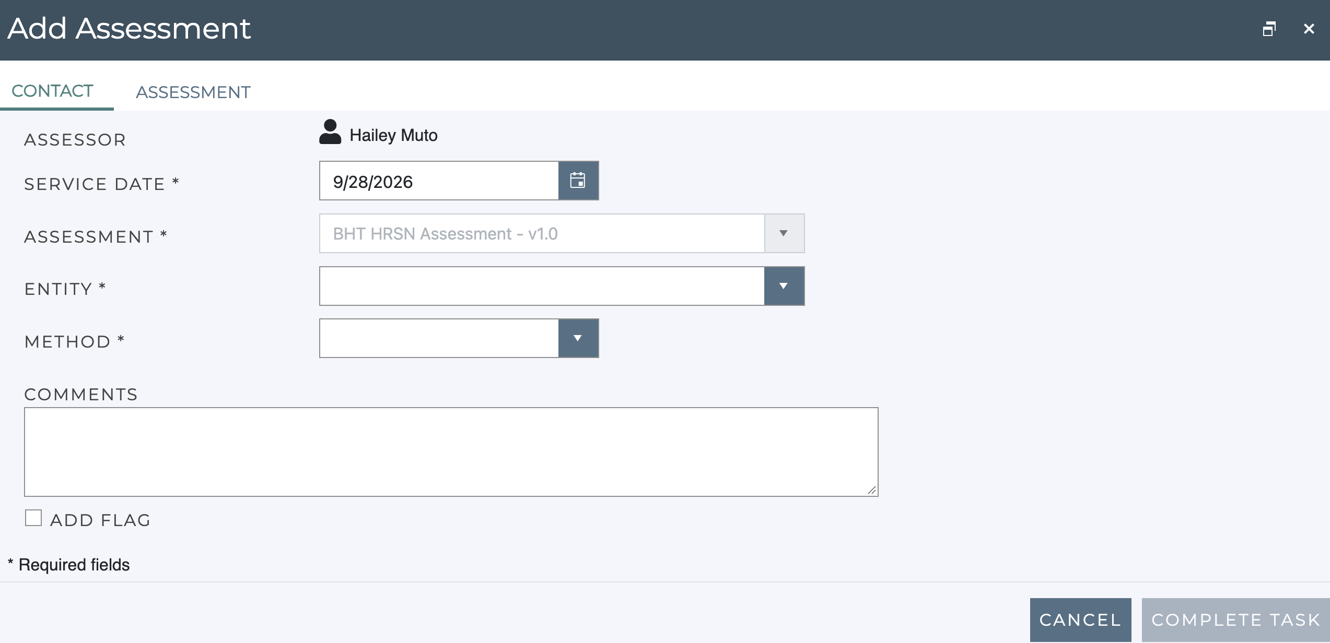
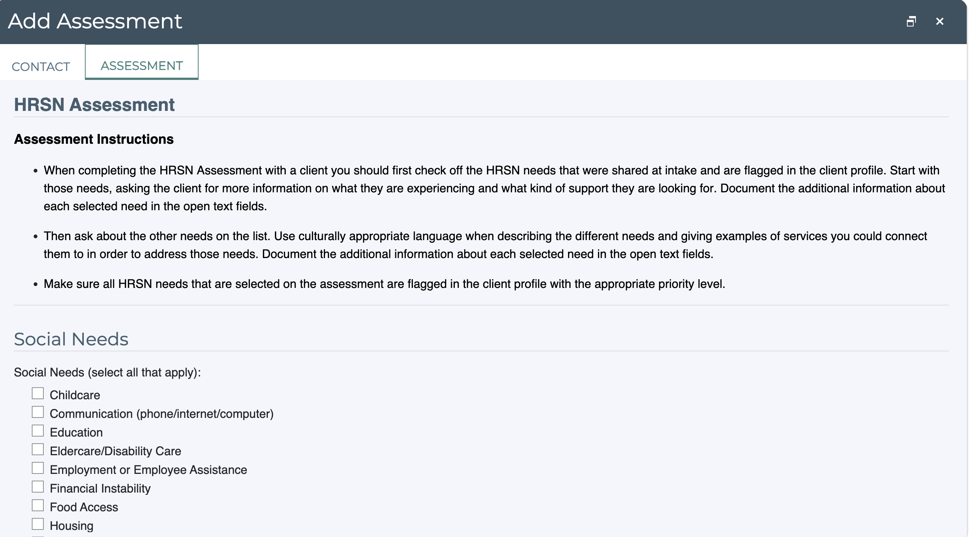
Complete HRSN Assessment Continued…
Notes:
Let’s go to Dashboard and then click All

Slide 10
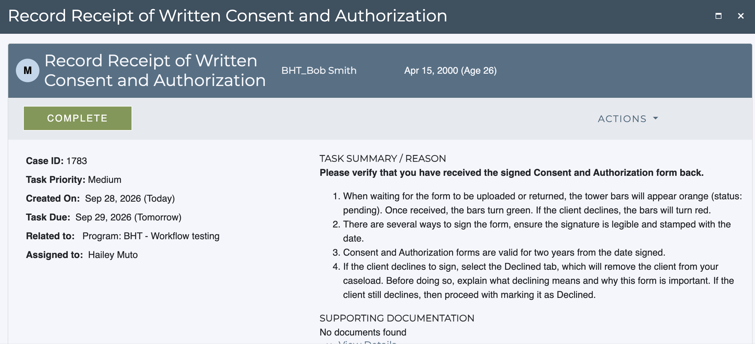
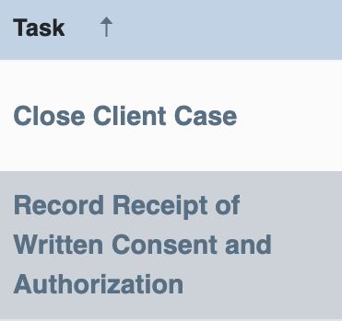
Record Receipt of Written Consent and Authorization

Slide 11
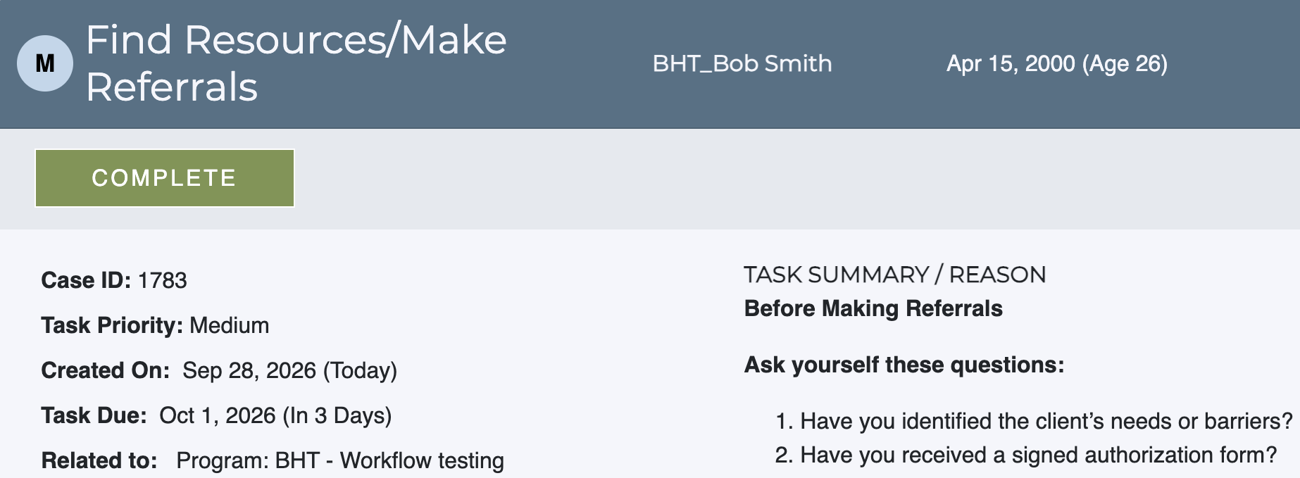
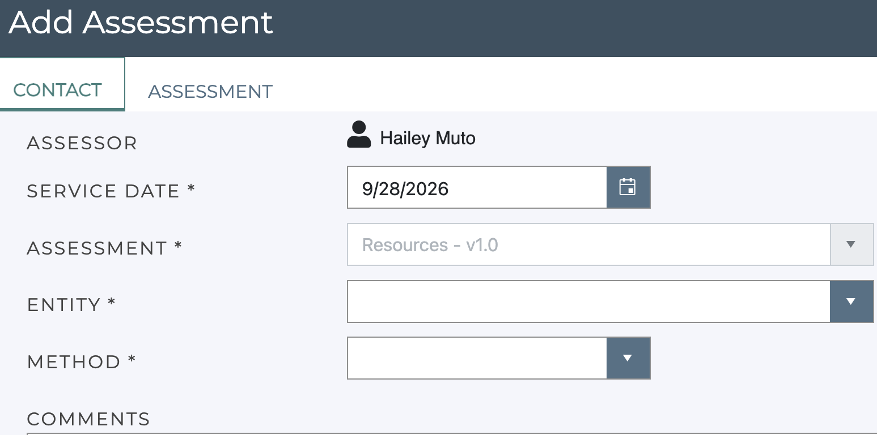
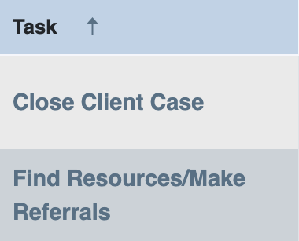
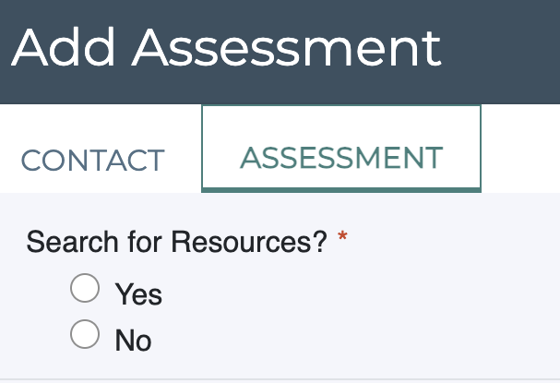
Find Resources/ Make Referrals

Slide 12
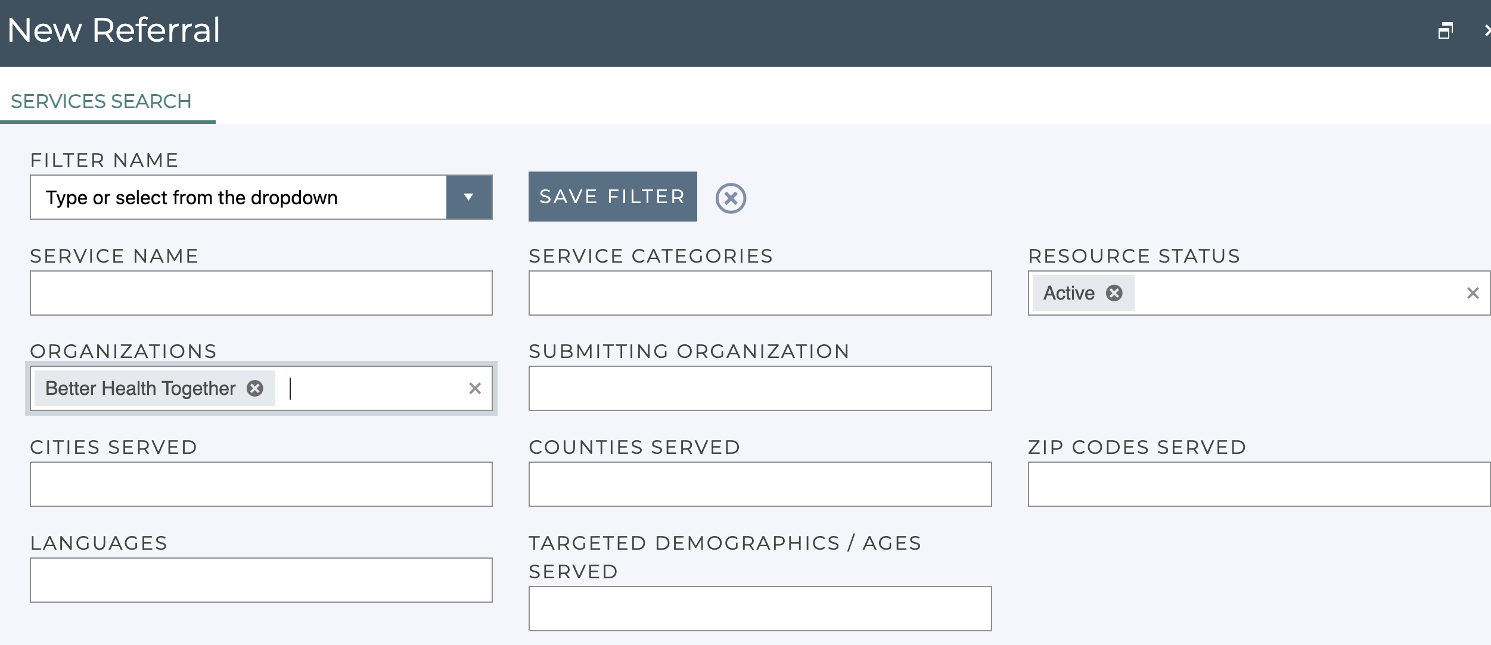
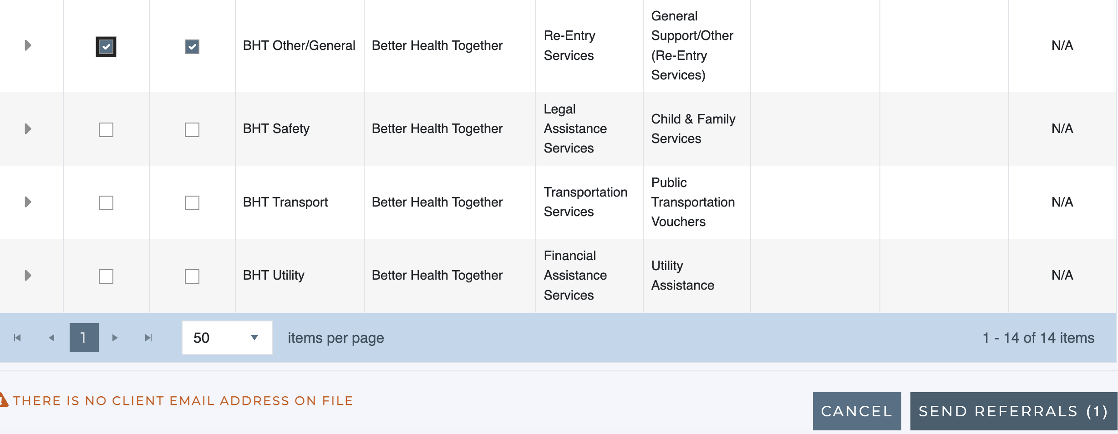
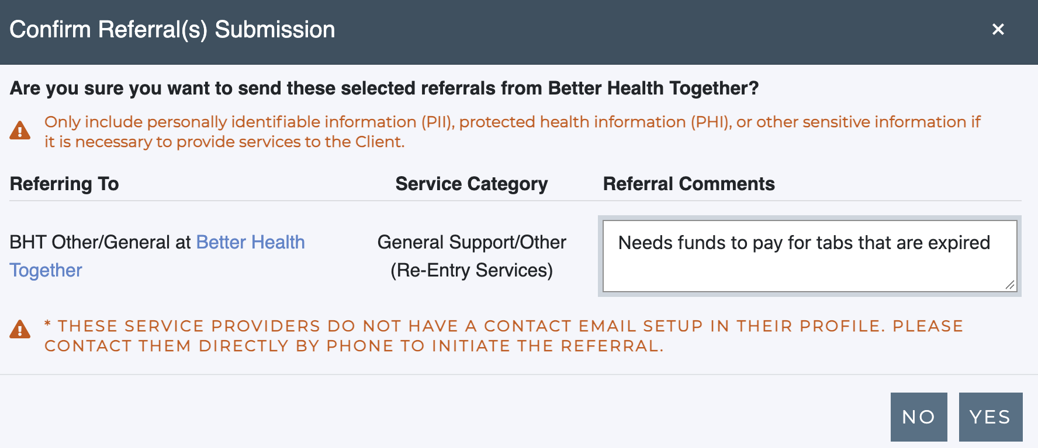
Find Resources/ Make Referrals Continued…

Slide 13
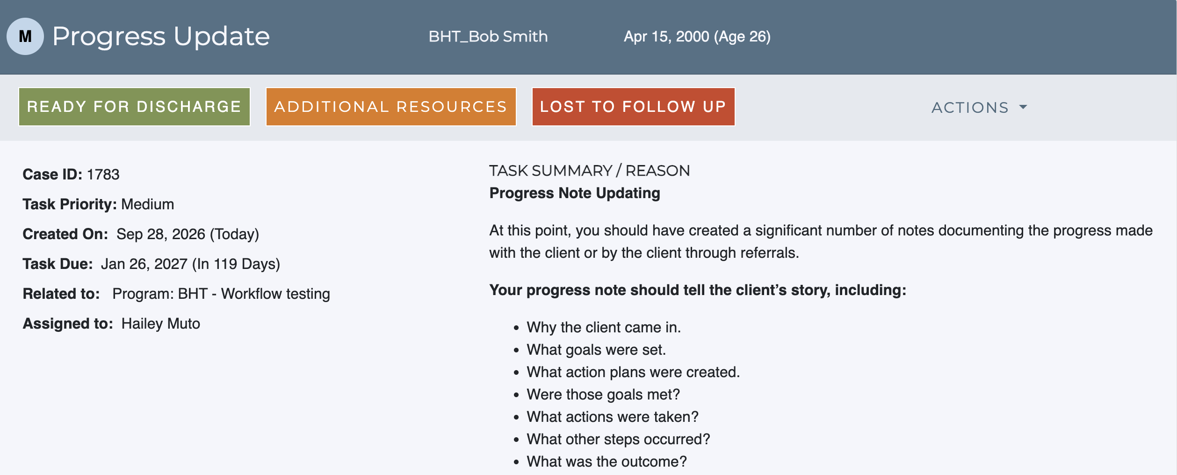
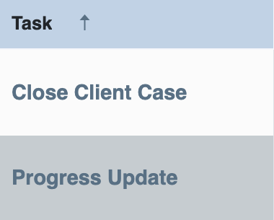
Progress
Update

Slide 14
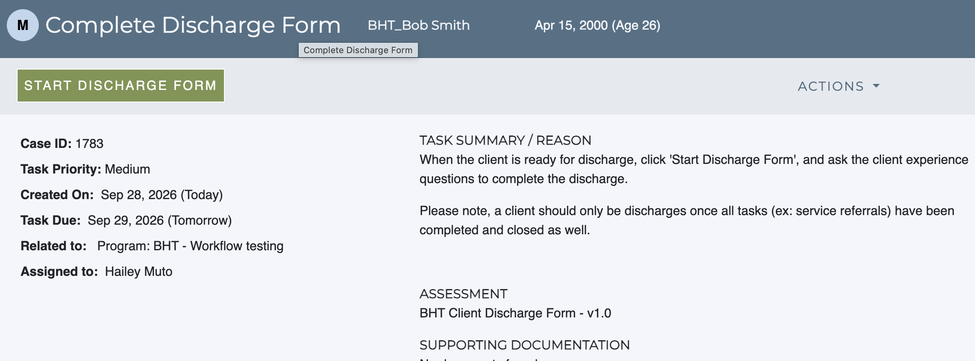
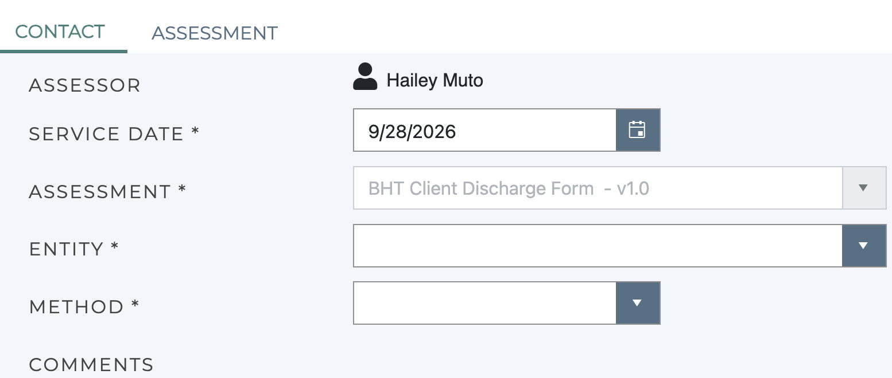
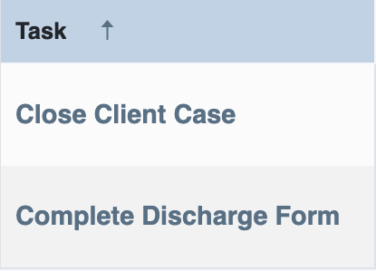
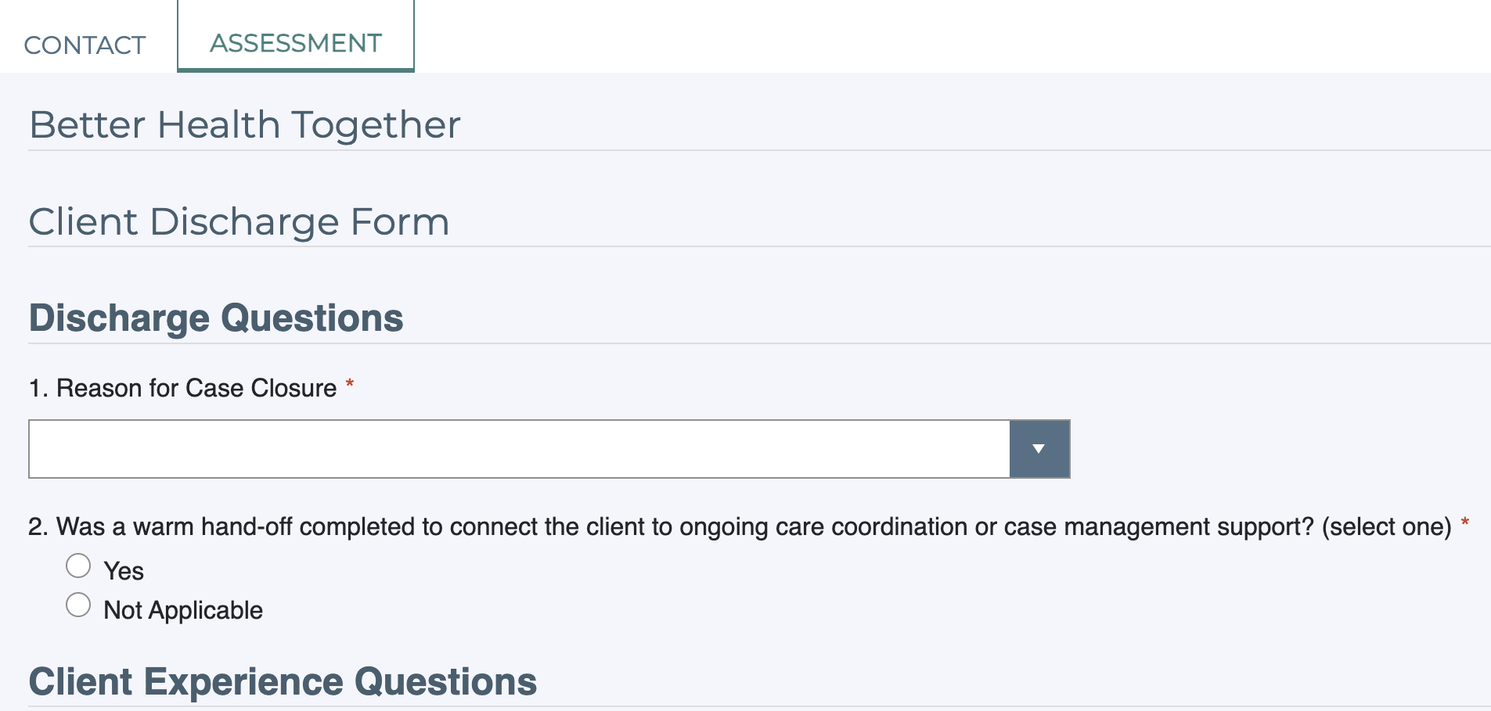
Complete Discharge Form

Slide 15
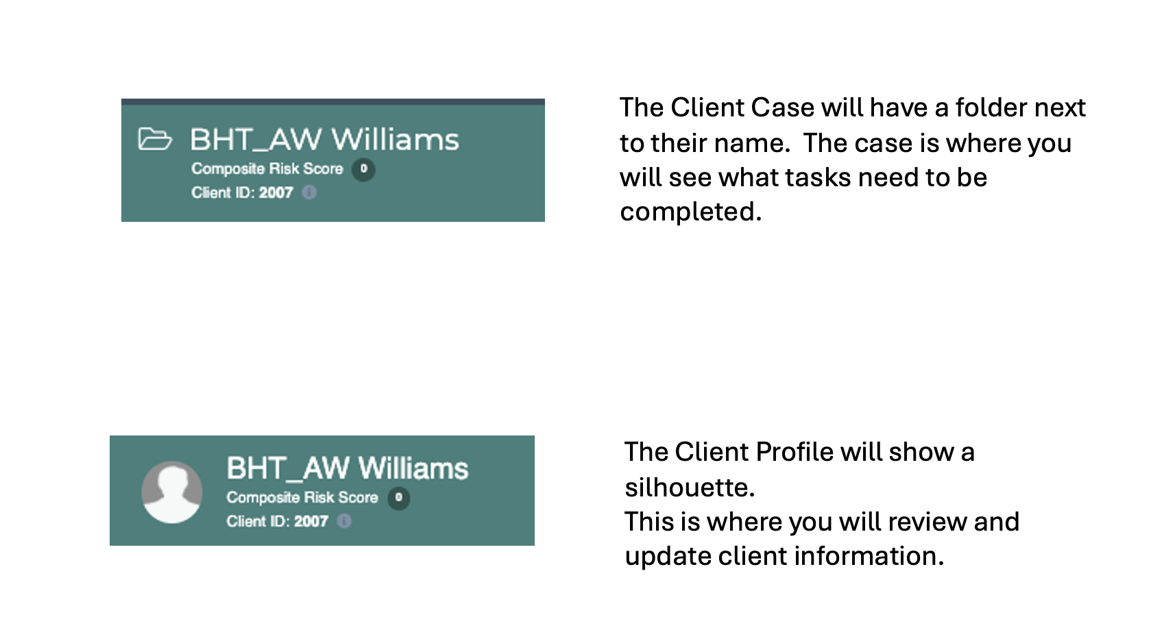
Client Case vs Client Profile
Notes:
Double-click on the client's name on the Client Case view to open the Client Profile.

